Slide 1


SMART TIME TABLE GENERATION FLUTTER APP USING GENETIC ALGORITHM
A Minor Project Report
in partial fulfillment of the degree
Bachelor of Technology
in
Computer Science & Artificial Intelligence
By
2003A51167 K.SRIVARDHAN
2003A51173 M.NAVYA SRI
2003A51177 R.BHUMIKA
Under the Guidance of
Dr. K. Chandhar, Asst. Prof
Submitted to
SCHOOL OF COMPUTER SCIENCE & ARTIFICIAL INTELLIGENCE
SR UNIVERSITY, ANANTHASAGAR, WARANGAL
April, 2023.

Slide 2
ABSTRACT
This project attempts to overcome timetable is needed to be scheduled in such a way that the number of different courses with a number of subjects in each, handled by a limited faculty provided with their slots and timings does not overlap.
Time table generation is tedious job for educationalist with respect to time and man power.
Providing a automatic time table generator will help to generate time table automatically.
It avoids the complexity of setting and managing Timetable manually.
In our project we are going to use genetic algorithm scheduling to reduce these difficulties of generating timetable.
This algorithm incorporate a numeral of strategy, aimed to improve the operativeness of the search operation.
The system will take various inputs like number of subjects, teachers, workload of a teacher, semester, priority of subject.
By relying on these inputs, it will generate possible time tables for working days of the week for teaching faculty. This will integrate by making optimal use of all resources in a way that will best suit the constraints.

Slide 3

PROBLEM STATEMENT
The timetable is a necessary blueprint for the efficient working of an academic institute.
There may arise a series of challenges in managing the timetable for an academic
institution, as the process involves a lot of manual work and scheduling of course units,
lecture time, lecture rooms, practical sessions and the faculty in-charge always finds it
difficult to make updates of the time tables properly as there can be collisions in various
lectures, tests or examinations.

Slide 4


OBJECTIVES
The main objectives of our project are:
The final system should able to generate time tables in completely automated way which will save a lot of time and effort of an institute administration.
To make a timetable system generic so that I can work equally well for different Colleges and Universities.
Ease of use for user of system so that he/she can make automatic timetable.
Focus on optimization of resources i.e. teachers, labs and rooms etc.
Provide a facility for everyone to view timetable.
Generate multiple useful views from time table.

Slide 5
Literature Review
For motivation and Background work we refered to some of the following
Research Papers from online. They are:
Timetable generation algorithms based on Genetic Algorithm.
Multi-objective fuzzy-based adaptive memetic algorithm with hyper-heuristics to
solve university course timetabling problem.
Time table Generation Based on Heuristic Approach.
Design and implementation of course timetabling system based on genetic algorithm.
A Greedy and Genetic Fusion Algorithm for Solving Course Timetabling Problem.

Slide 6
Proposed Methodology
This system will help the colleges to generate the timetable automatically without any manual workload and saves a lot of time that plays a prominent role in the present lifestyle.
We can also generate the reports like Faculty load, Lab occupancy, Free slots etc..
It provides an easy means for data entry and revision through an intuitive interface.

Slide 7
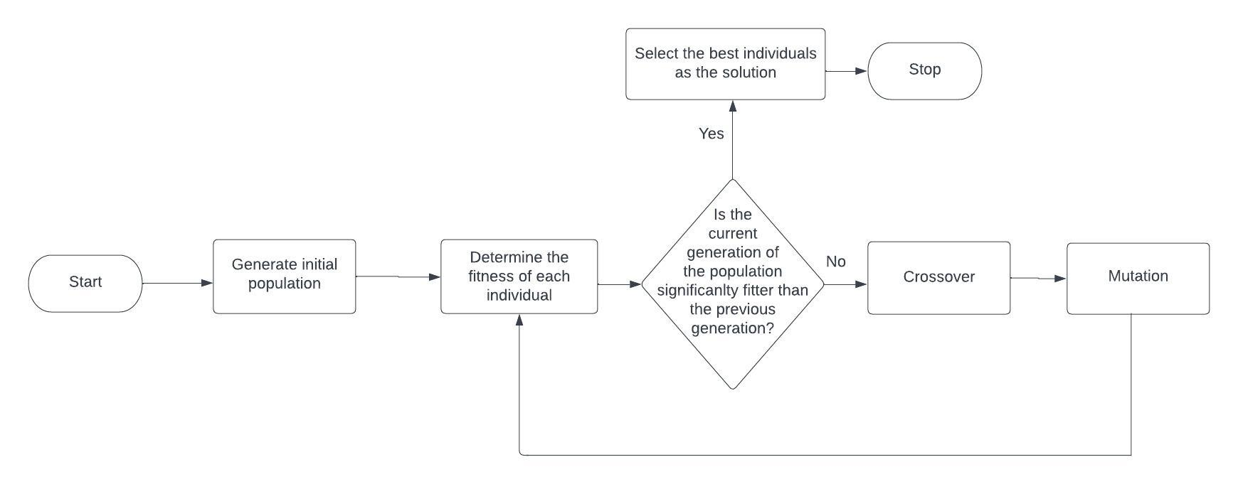
Proposed Alogirithm
Genetic algorithms are based on the ideas of natural selection and genetics.
The whole method of scheduling based on genetic algorithm is explained in detail in this section. A scheduling procedure is divided into several important modules are as follows,
Data encoding and decoding
Initial population
Evaluation of population
Crossover Evolution
Mutation
New Population

Slide 8
DATA SET
Faculty Details: Name, Faculty id, password, contact
Student details: Student name, Student login id, password
In the login pages of student and faculty
1.Course name
2.Branch
3.Update profile are also included
Departments
subjects

Slide 9
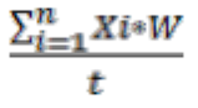
Genetic Algorithm
Data encoding and decoding: It transforms a solution into a chromosome to get a simple value, like a string. An easy way to do is to converting the data into a binary string.
Initial population: It consists of creating a number of random individuals using hard constraints. The population choice depends on the needs of the user.
Evaluation of population: The fitness of a solution is the estimation of how good the solution is, using soft constraints. At this range, the solution is valid.
Fitness Function:
Fitness of the timetable is calculated by below eq.:
F(X)=
where, x = timetable under evaluation process, w = number of Constraints.
t = total fitness value.
Crossover Evolution: The crossover evolution is a method used for the creation of a new population, based on older population.
Mutation: It consists of changing the values of a gene randomly, resulting in a new unexpected solution.
New Population: The crossover and the mutation permit to create a new population of original solutions.

Slide 10
PREDICTION OF GENETIC ALGORITHMIN TIMETABLE
The genetic algorithm predicts the way that the timetable is scheduled for the faculty so that there will be no clashes in maintaining different classes by different faculty. This provides a healthy environment in the Universities such that all classes will run smoothly without any disturbances.

Slide 11
RESULT :
The system is build to help the faculty to handle the classes smoothly without any overlaps of any classes or times slots.
Any changes or updates can be done easily without spending much time.
Easy accessibility for the faculty in any time and can search for any student details quickly.

Slide 12
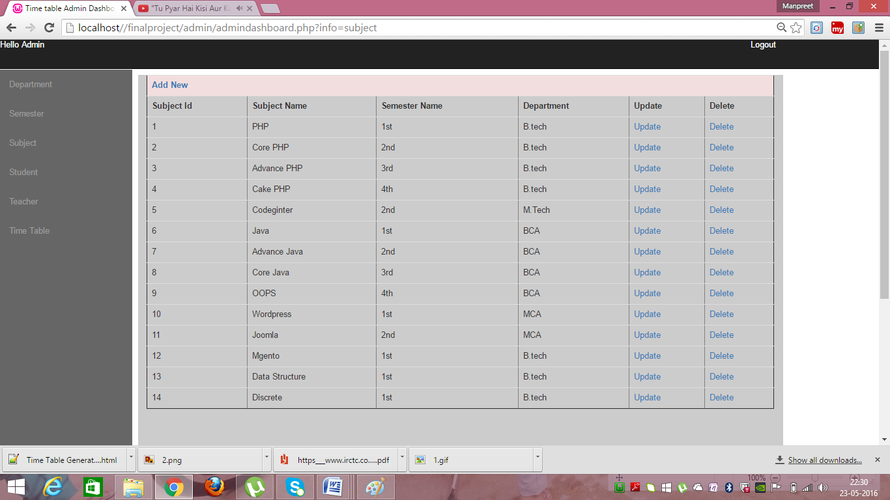
Results
Subjects

Slide 13
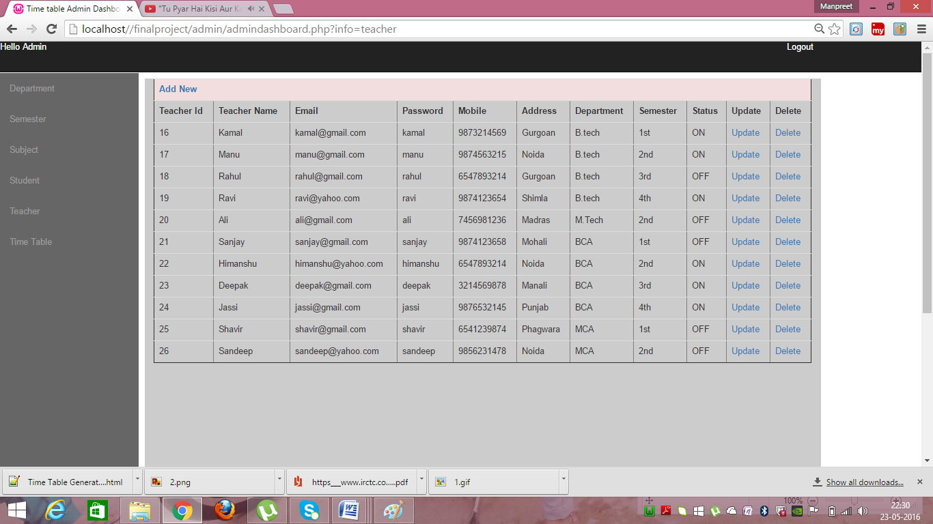
Results
Teachers

Slide 14
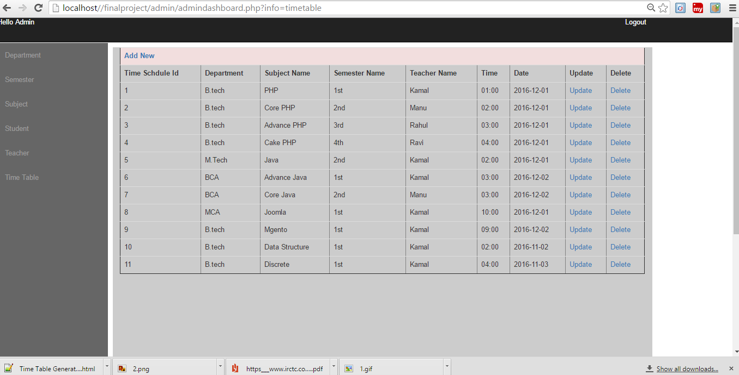
Results
Time schedule

Slide 15
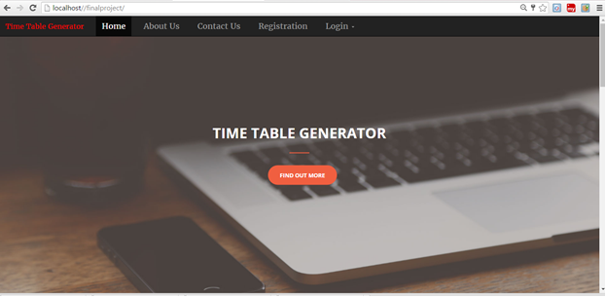
Web Page Format

Slide 16
CONCLUSION:
Here we conclude that the generating automatic timetable using the genetic algorithm
proves easy way of handling time slots and classes for the faculty and also to update and
enter the details of course or student secure and in an easy manner. This technique
(genetic algorithm) used helps in reducing to minimum errors and mistakes are
encountered in developing an automatic timetable.

Slide 17
References
https://core.ac.uk/download/pdf/234645405.pdf
https://www.ijert.org/automated-timetable-generation-using-genetic-algorithm

Slide 18
THANK YOU

